Slide 1

From Zero to Power BI Hero in 30 Days
Team Members
Umesh Reddy
Praveen
Amar

Slide 2

30 Days Power BI
Introduction of Microsoft Power BI

Slide 3


INTRODUCTION TO MICROSOFT POWER BI
The cutting-edge business analytics
tool

Slide 4
WHAT IS MICROSOFT POWER BI?

Slide 5

OVERVIEW OF MICROSOFT POWER BI
Cloud-based business intelligence
Power BI is a cloud-based business intelligence service that provides a single view of your most critical business data, accessible from anywhere with internet access.
Data integration and connectivity
With Power BI, you can connect to a wide range of data sources, including Excel, SQL Server, and cloud-based data services, and create interactive dashboards and reports that provide actionable insights.
Interactive dashboards and reports
Power BI allows you to create interactive, immersive dashboards and reports that
provide actionable insights and drive business results.

Slide 6

BENEFITS OF USING POWER BI
Ease of Use
Power BI's drag-and-drop interface makes it easy for even non-technical users to create stunning visualizations and interactive reports.
Real-Time Updates
Power BI provides real-time updates, allowing you to stay on top of your data and
make informed decisions.
Mobile Access
Power BI's mobile app allows you to access your data and reports from anywhere, making it easy to stay connected and make informed decisions on-the-go.

Slide 7
HOW TO USE MICROSOFT POWER BI

Slide 8

CONNECTING DATA SOURCES TO POWER BI
Data Connectors in Power BI
Power BI provides a wide range of data connectors that enable you to connect to popular data sources such as Excel, SQL Server, and SharePoint. These connectors help you to access data from different sources and create a unified view of your data for analysis.
Connecting to Excel Data Sources
Excel is a popular data source and can be easily connected to Power BI. You can connect to an Excel workbook stored in OneDrive or SharePoint, or you can upload an Excel workbook directly to Power BI.
Connecting to SQL Server Data Sources
SQL Server is a popular database management system and can be easily connected to Power BI. You can connect to a SQL Server database hosted in the cloud or on-premises, and you can use DirectQuery or Import mode to access your data.

Slide 9

CREATING VISUALIZATIONS
Types of Visualizations
Power BI provides a wide range of visualization types, including charts, tables, and maps, that enable you to create stunning reports and dashboards.
Customizing Visualizations
Power BI enables you to customize your visualizations to meet your specific needs, such as adding labels, filters, and formatting options.

Slide 10
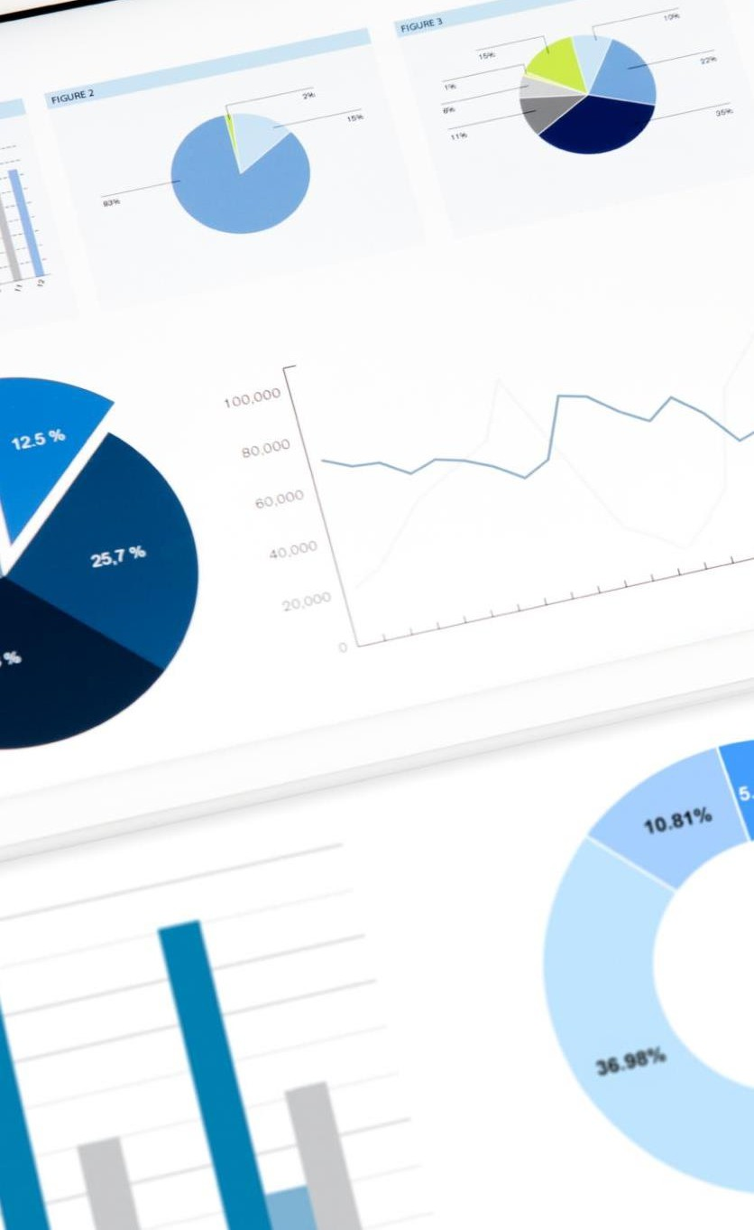
BUILDING DASHBOARDS
Dashboard Design
Effective dashboard design plays a crucial role in conveying actionable insights to the stakeholders. We will learn how to design an intuitive dashboard layout that provides a 360-degree view of your most critical business data.
Data Visualization
Adding the right visualizations to your dashboard can help you convey insights more effectively. We will explore how to choose the right visualizations for your data and how to create them using Power BI tools.
Dashboard Publishing
Publishing your dashboard to the Power BI service is an important step in sharing your insights with the stakeholders. We will learn how to publish your dashboard to the Power BI service and how to share it with others.

Slide 11
ADVANCED FEATURES OF MICROSOFT POWER BI

Slide 12

DATA MODELING IN POWER BI
The data modeling engine in Power BI provides a powerful tool that can transform raw data into a structured format that can be easily analyzed. This enables you to create complex data models that can be used to drive your business decisions.

Slide 13

POWER QUERY EDITOR
Data Transformation
Power Query Editor is a powerful data transformation tool that enables you to clean, reshape, and combine data from multiple sources. You can use Power Query Editor to perform a wide range of data transformations, including filtering, sorting, grouping, and merging data from different sources.
Data Cleansing
Power Query Editor enables you to clean your data by removing duplicates, filling in missing values, and correcting inconsistent data. You can use Power Query Editor to perform data cleansing tasks on different types of data, including text, numbers, and dates.
Data Reshaping
Power Query Editor enables you to reshape your data by pivoting columns, unpivoting rows, and transposing data. You can use Power Query Editor to reshape your data in a way that makes it easier to analyze and visualize in Power BI.

Slide 14

POWER BI ADMINISTRATION
Security and Access Controls
Power BI provides a range of security and access control features that enable you to control who has access to your data and how they use it. We will explore how to set up security groups, manage roles and permissions, and configure row-level security.
Usage Monitoring
Power BI provides a range of usage monitoring features that enable you to track how your data is being used and identify any issues or anomalies. We will explore how to monitor usage metrics, set up alerts, and configure usage reports.
Data Refresh Settings
Power BI provides a range of data refresh settings that enable you to control how frequently your data is refreshed and ensure that the data is up to date. We will explore how to configure data refresh schedules, manage data sources, and troubleshoot data refresh issues.

Slide 15
CONCLUSION
Powerful data analytics
User-friendly interface
Real-time data
monitoring
Power BI allows businesses to monitor data in real-time, making it easy to identify trends and make quick decisions.
Collaboration and
sharing
Power BI enables business users to collaborate and share reports easily, improving communication and decision- making.
Power BI provides powerful data analytics that enable businesses to make informed decisions.
Power BI has a user-friendly interface that makes it easy for business users to create and share reports.

